Slide 1




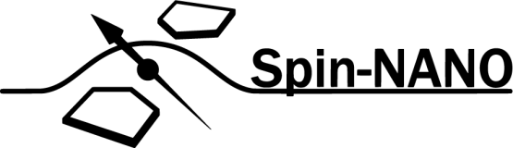
A Multi-Node Quantum Network with Defects in Diamond
Ph.D. Proposal - Matteo Pompili

Slide 2
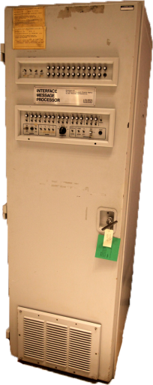

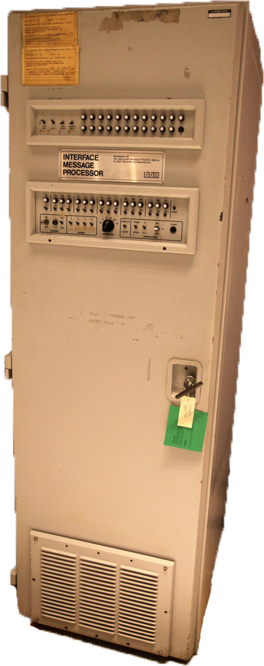
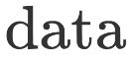
What is a (Quantum) Network?
Notes:
Network allow to share data and resources between computers, even when not directly connected

Slide 3
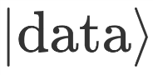
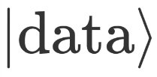
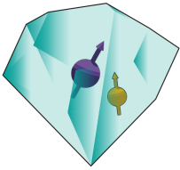

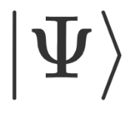
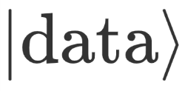

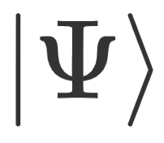

What is a (Quantum) Network?
Notes:
Objective is to share quantum data / resources
Cannot use same method, No-Cloning Theorem
Going to use entanglement instead

Slide 4




What is a (Quantum) Network?
Known applications:
Quantum Key Distribution (QKD)
Blind quantum computation
Distributed quantum computation
Clock Synchronization
Leader election
…

Slide 5
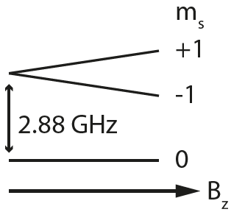
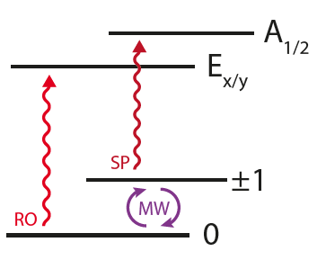
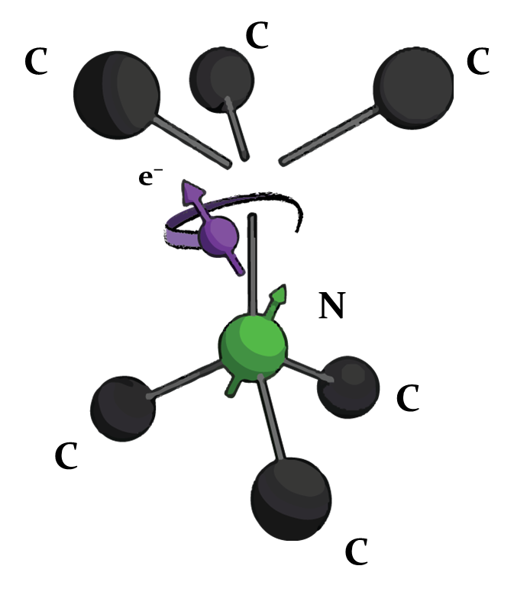

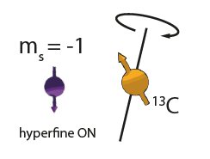
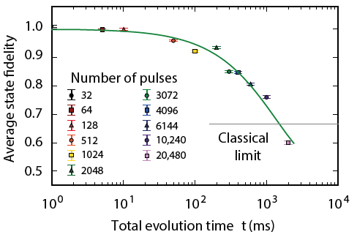
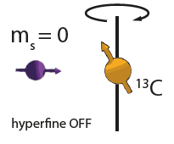
The Nitrogen Vacancy Centre in Diamond
C¹³
M. H. Abobeih et al. Nature Comm. 2018.
C¹³
Notes:
NV is a defect in diamond
Electronic triplet ground state
Bright optical transitions: single shot readout and initialization
MW coherent control of the qubit
Carbon13 can be used as quantum memories with second coherence time
Coherence time of electron > 1s

Slide 6
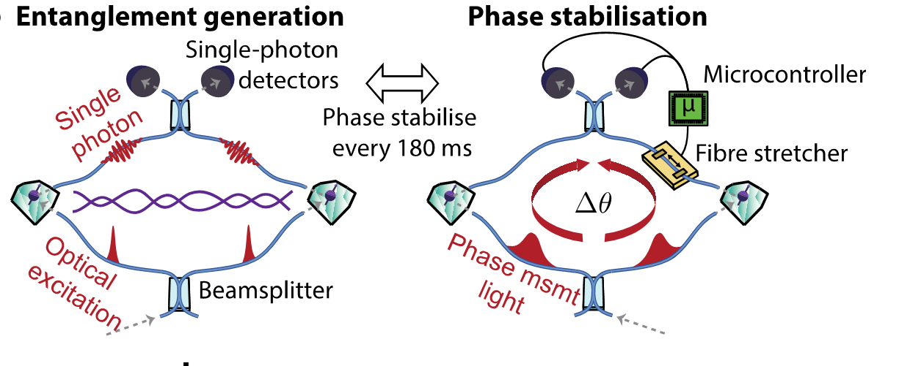
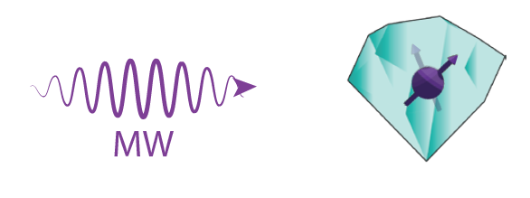
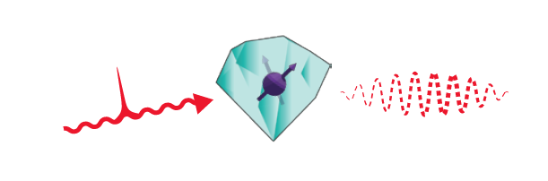
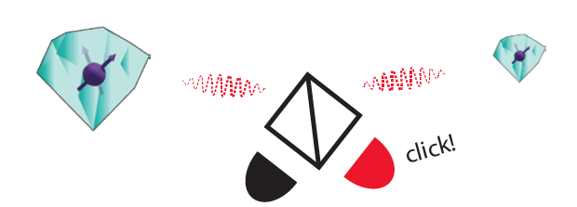
Single Click Entanglement
P C Humphreys et al., Nature 558, 268–273 (2018)
Notes:
Superposition
Spin-photon entanglement
Single photon detection
Physical realization
Phase stabilisation

Slide 7
First year of PhD
Built third node (LT5)
Tested improvements for all setups:
Faster microprocessor
Fibre based laser control
Improved control of laser pulses
Faster phase stabilisation

Slide 8
Research goals
Demonstration of quantum applications on a multi-node network
Generation of genuine multipartite entangled states,
Proof of principle demonstration of the Link layer of the future Quantum Internet stack,
Teleportation of entanglement in a four node network,
Client-Server secure delegation of quantum computation.
Notes:
Main goal:
Achieved via 4 experiments

Slide 9
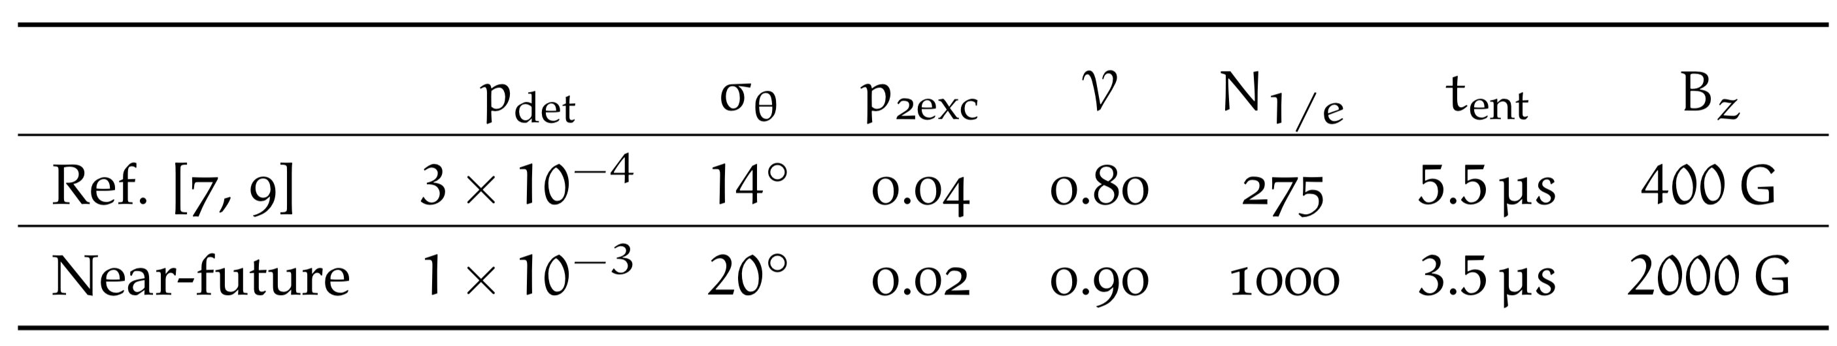
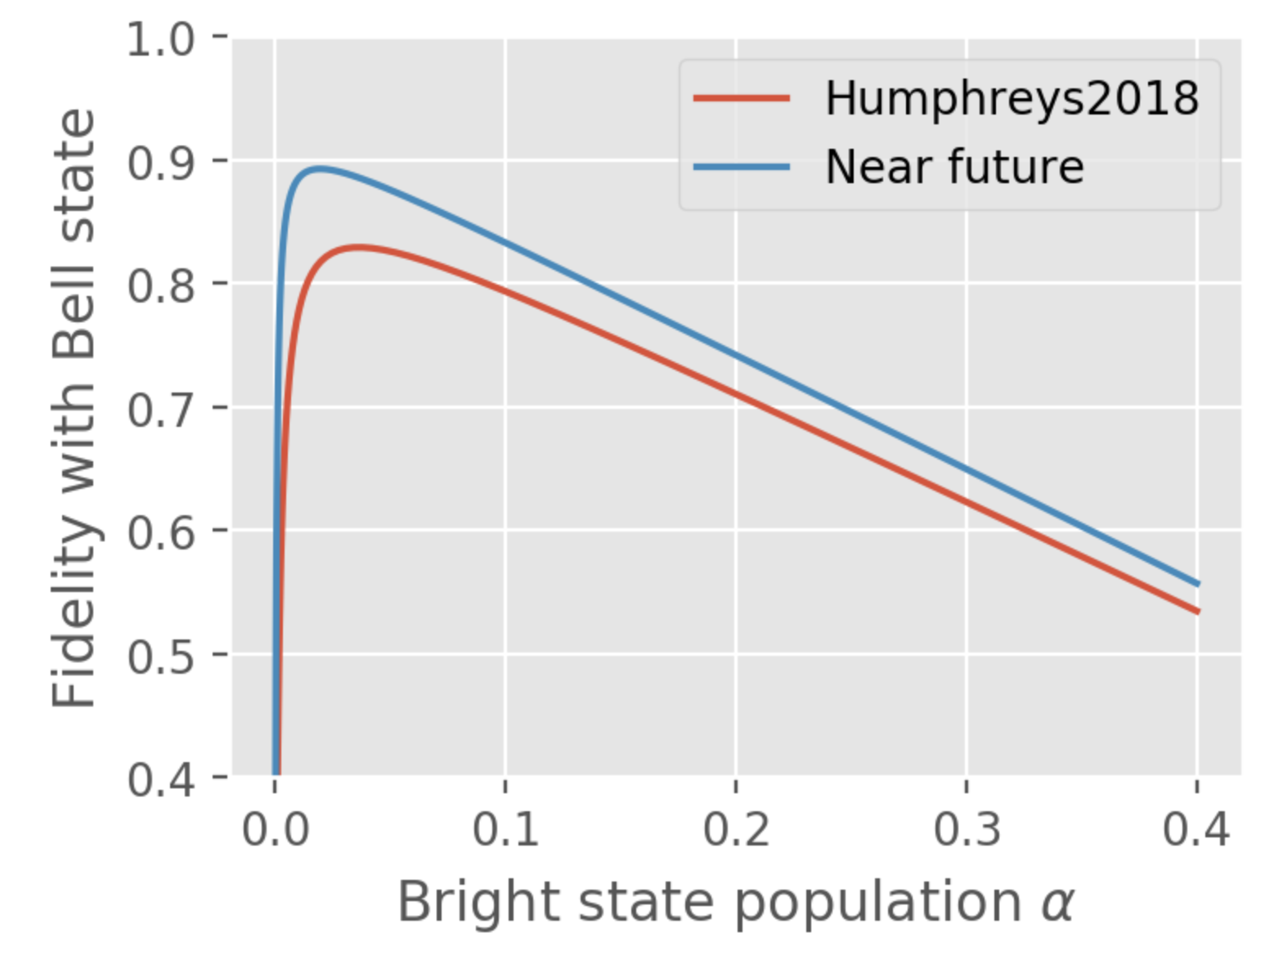
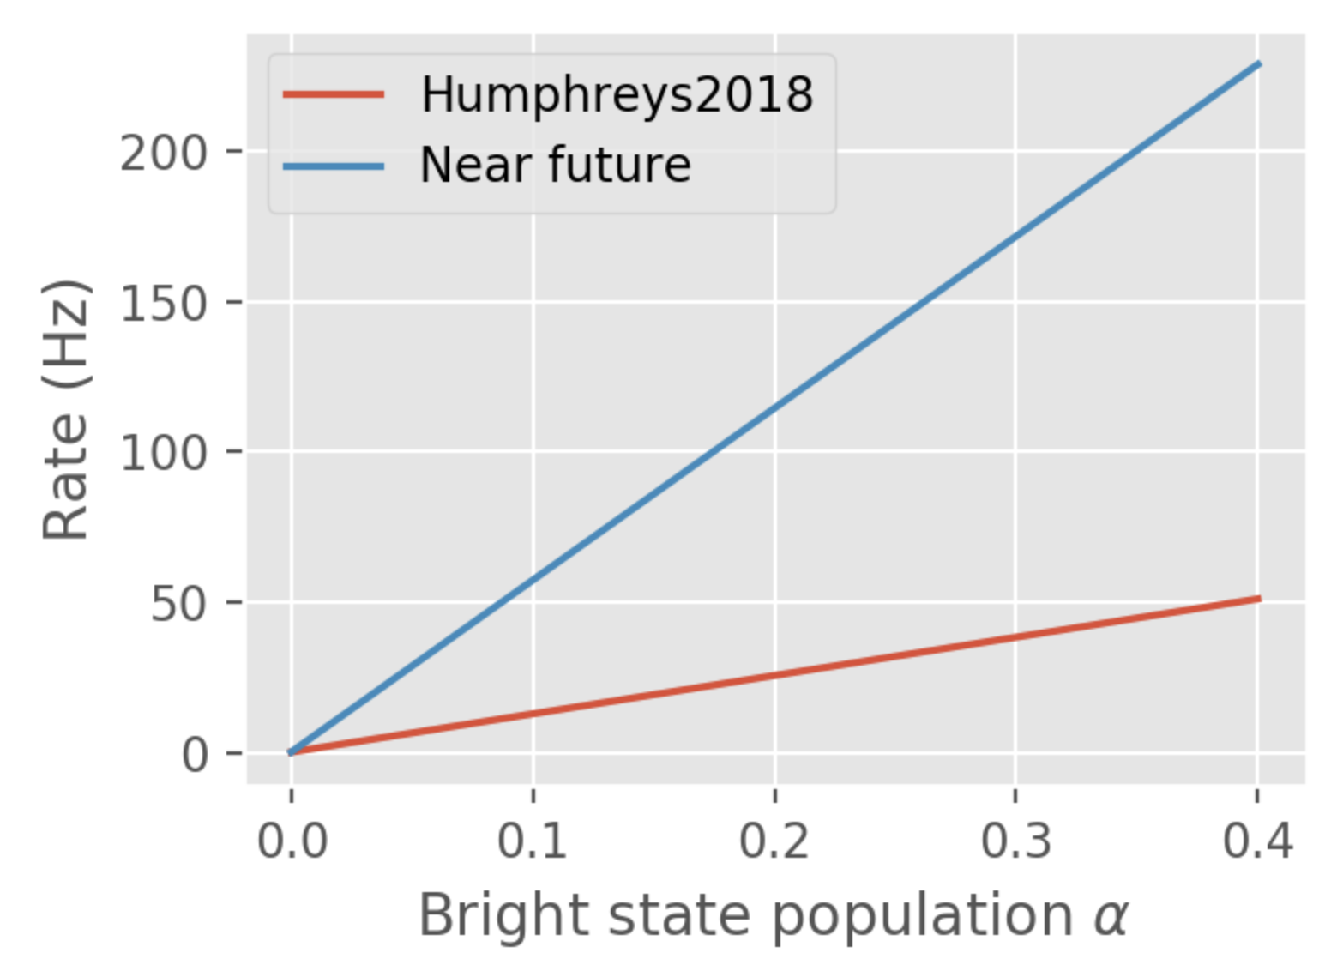
Genuine Multipartite Entanglement
Humphreys2018
Notes:
Pdet, P2exc, tent improved via improvements of control electronic and optics
Sigma theta is bigger, but so is the interferometer!
Lifetime of memories improved by higher magnetic field

Slide 10
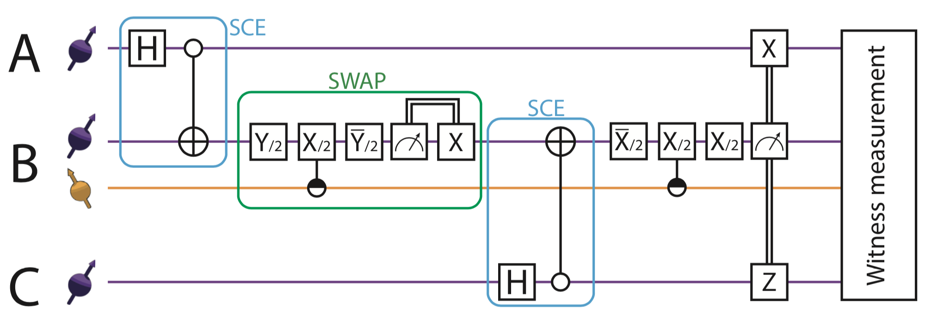
Genuine Multipartite Entanglement
Notes:
The middle node will need a memory qubit
Second round of entanglement will need to be fast,
TALK ABOUT TWO PARAMETERS!
Witness to efficiently measure the fidelity of the state

Slide 11
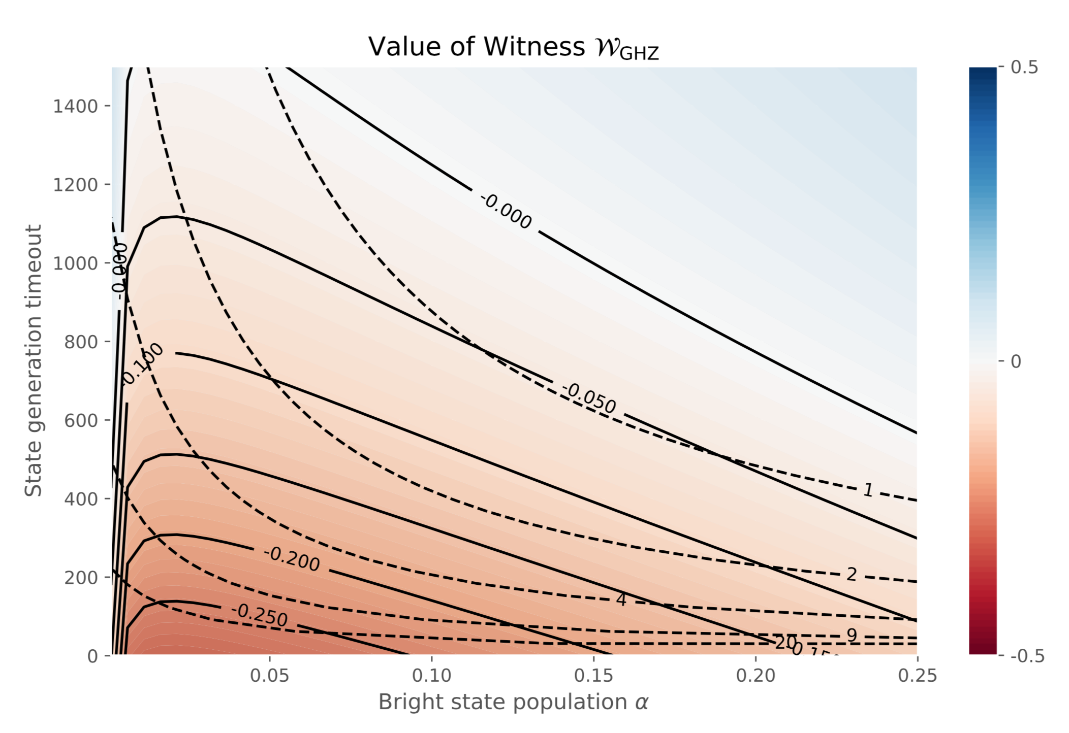
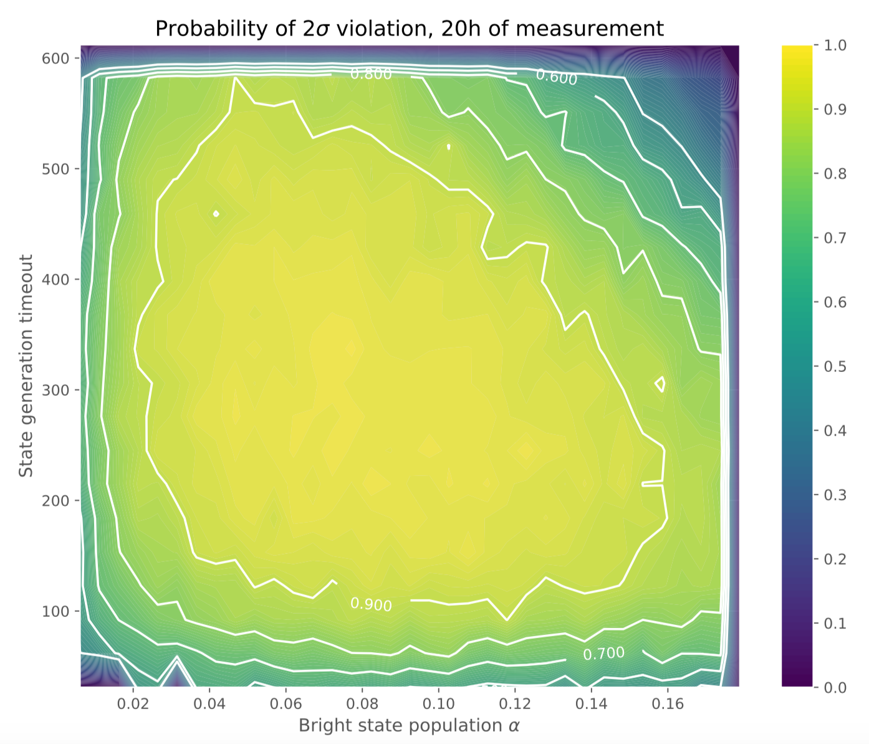
Genuine Multipartite Entanglement
Notes:
We can vary the two parameters and get different values for the witness
Solid lines, dashed lines
Given a certain measurement time, we can optimise on the parameters to achieve highest statistical significance

Slide 12
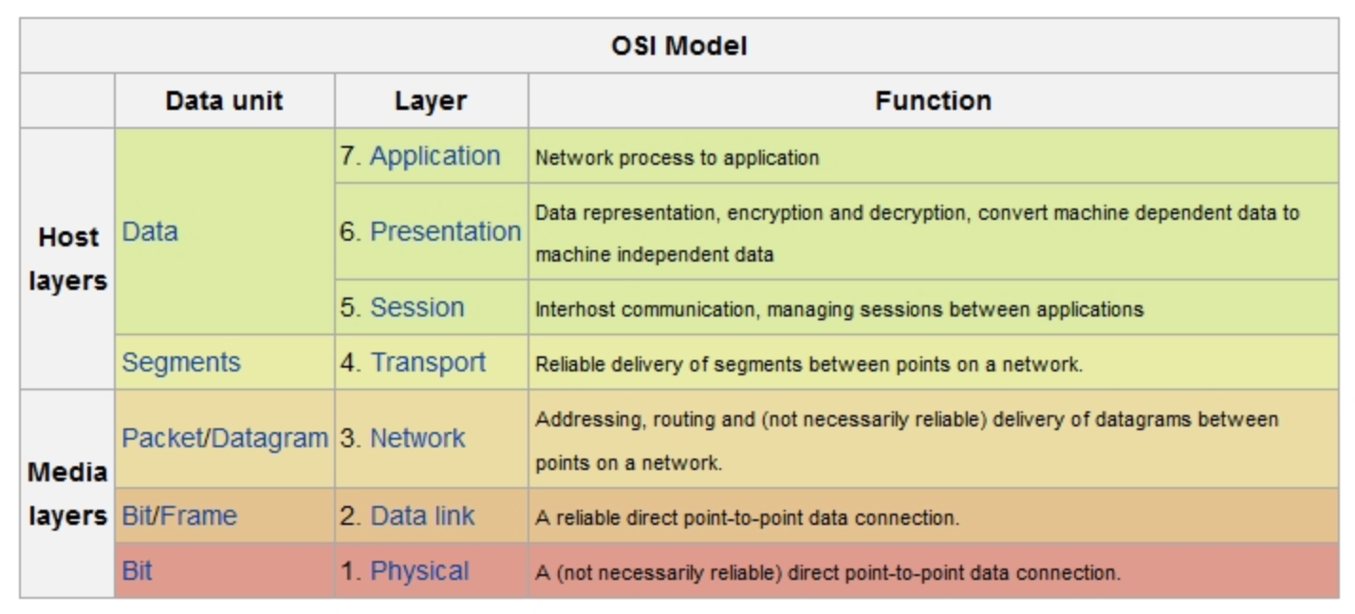
Link Layer Demonstration
This is the final target
Next step
We are here
Notes:
Reliable entanglement generation

Slide 13
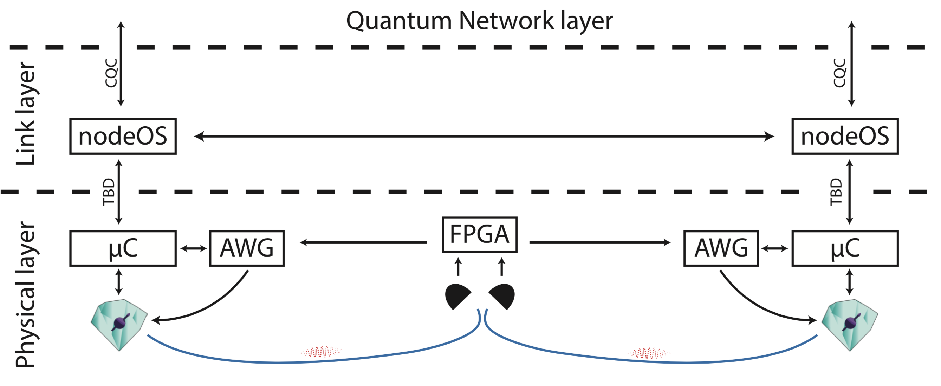
Link Layer Demonstration
Notes:
Current experiments only used the Physical layer

Slide 14
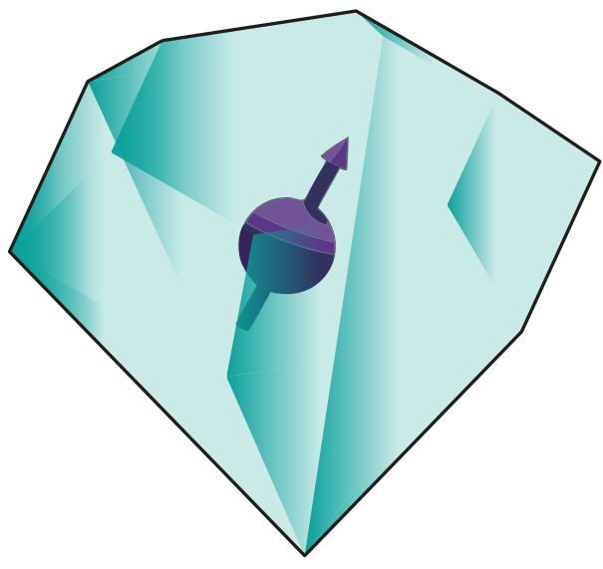
Teleportation of Entanglement

Slide 15
Teleportation of Entanglement
Main challenges:
Build a 4th setup
Run 4 nodes at the same time

Slide 16
Client-Server Secure Delegation
Send N random qubits
Client
O(1) qubits
Server
N qubits
Tell measurements to run
Report results
- Result of computation only known to Client
- Detail of the computation only known to Client
- Client can check if Server is truly quantum

Slide 17

Client-Server Secure Delegation
Client
Teleport
Teleport
Teleport
Server
U₁
Z
U₂
Z
U₃

Slide 18
Client-Server Secure Delegation
Main challenges:
Increase number of memory qubits
While increasing their lifetime
Adaptive operations / measurement

Slide 19
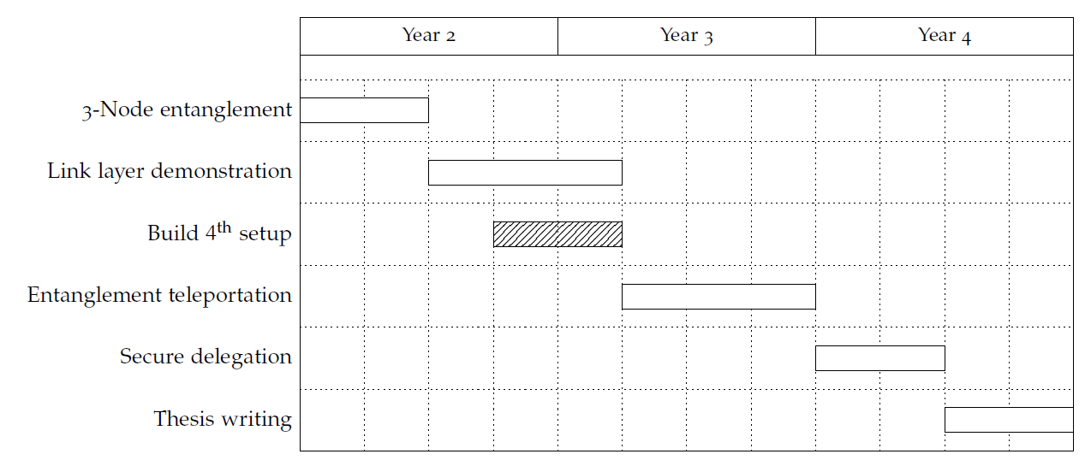
Proposed Ph.D. Timeline

Slide 20
Thanks!

